Slide 1
Dependency Injection by setter method
inject the dependency by setter method.
The <property> subelement of <bean> is used for setter injection. we are going to inject primitive and String-based values Dependent object (contained object)Collection values etc.

Slide 2
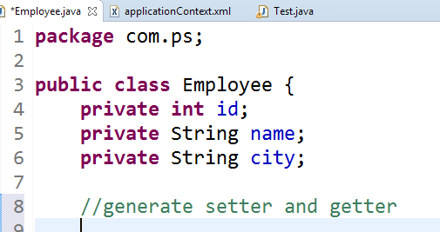
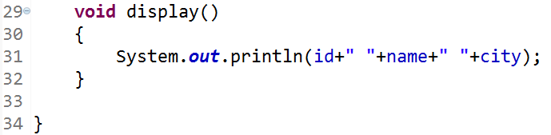

Slide 3
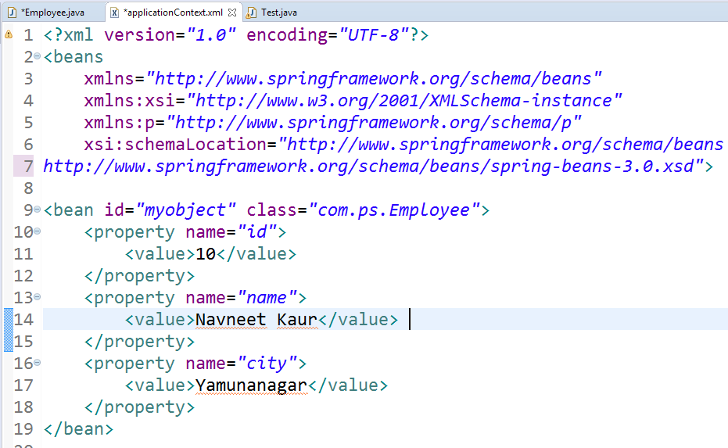

Slide 4
